Slide 1



AUTOMATED PERSONAL EXPENDITURE MONITORING SYSTEM DEVELOPED IN C++
DSA0109 - OBJECT ORIENTED PROGRAMMING WITH C++
Presented By :
M . Sasidhar(192425304)
P . Muni Karthik(192425061)
P . Karthekeya(192411093)
Under the supervision of
Dr. I . Sudha

Slide 2
INTRODUCTION
Managing personal finances manually can make it difficult to track spending patterns, monitor budgets and determine actual savings.
Key capabilities
Records income and expenditure
Organizes transactions by category
Provides category-wise spending analysis
Presents financial information through an interactive dashboard
Maintains financial records using persistent storage
Calculates income, expenses and balance
Monitors monthly budget utilization

Slide 3
OBJECTIVES
Project Objectives
The primary objective is to develop a reliable and user-friendly system for monitoring personal financial activity.
Record income and expense transactions systematically.
Categorize expenditure for better financial visibility.
Calculate total income, expenses and available balance automatically.
Monitor spending against a predefined monthly budget.
Analyze expenditure patterns using graphical representations.
Enable users to search, edit and delete transaction records.
Provide a foundation for future financial reports and enhancements.

Slide 4
PROBLEM STATEMENT
Problem Statement
Traditional personal expense tracking often depends on notebooks, spreadsheets or fragmented records
Difficulty maintaining consistent financial records
Limited visibility into spending patterns
Manual calculation of income and expenditure
Difficulty identifying high-spending categories
Lack of real-time budget utilization information
Increased possibility of calculation and recording errors

Slide 5
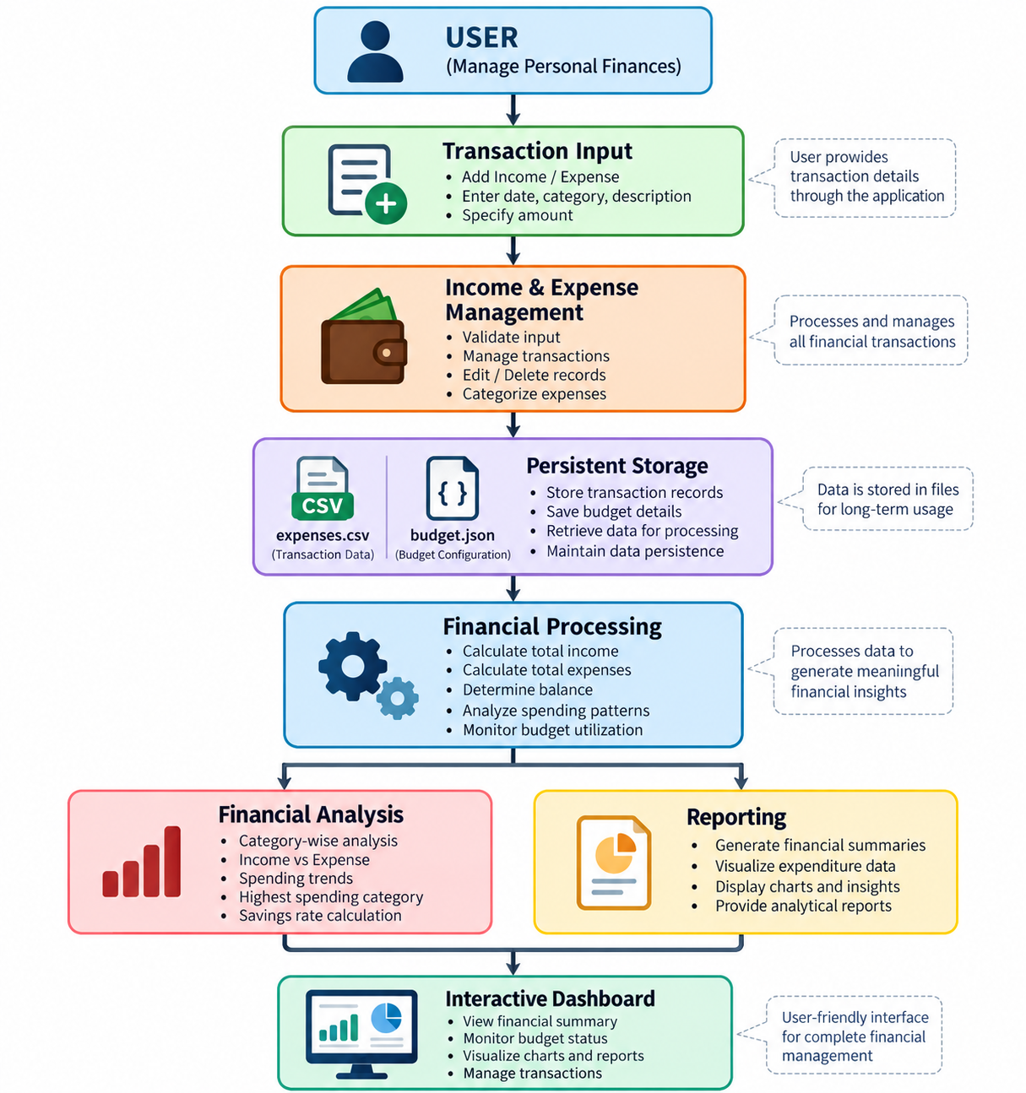
SYSTEM ARCHITECTURE

Slide 6
TECHNOLOGY STACK
Component | Technology
Core Programming | C++
Data Structures | struct, vector
File Handling | fstream
Data Format | CSV
Dashboard | Streamlit
Data Processing | Pandas
Visualization | Plotly
Budget Storage | JSON
Development | VS Code / Local Environment
Deployment | Streamlit Web Application

Slide 7
MODULE 1: INCOME & EXPENSE MANAGEMENT
Purpose: To provide a structured mechanism for recording, maintaining and managing personal financial transactions.
Key Functions:
Add income and expense transactions
Record date, category, description and amount
Store transaction data in CSV format
View complete transaction history
Search and filter financial records
Edit or delete existing transactions

Slide 8
MODULE 2: FINANCIAL ANALYSIS
& PLANNING
Purpose: To transform recorded transactions into meaningful financial indicators that support budgeting and expenditure analysis.
Key Calculations:
Total Income – Sum of all income transactions
Total Expense – Sum of all expenditure
Balance – Total Income − Total Expense
Savings Rate – (Balance / Total Income) × 100
Budget Remaining – Monthly Budget − Expenses
Financial Planning Features:
Monthly budget monitoring
Category-wise spending analysis
Income vs. expense comparison
Identification of highest spending category
Average daily expenditure calculation

Slide 9
MODULE 3: REPORT GENERATION
& FUTURE
Purpose: To convert processed financial data into understandable reports and analytical insights for effective expenditure monitoring.
Reports Generated:
Financial summary
Category-wise expenditure report
Income and expense comparison
Spending trend analysis
Highest spending category
Average daily spending
Number of expense transactions
Analytical Output:
Category-wise spending visualization
Automatic identification of highest spending category
Average daily expenditure
Number of expenses
Graphical financial reporting

Slide 10
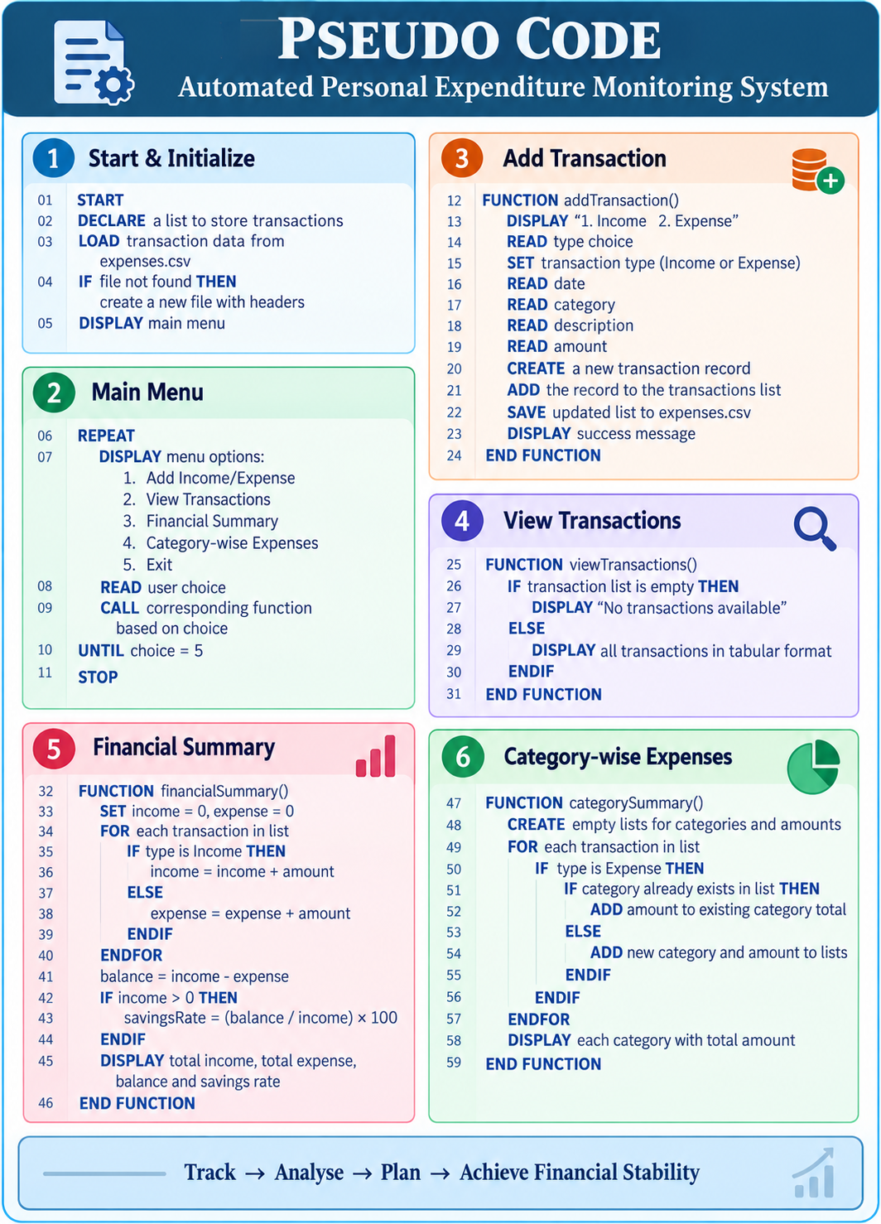

Slide 11
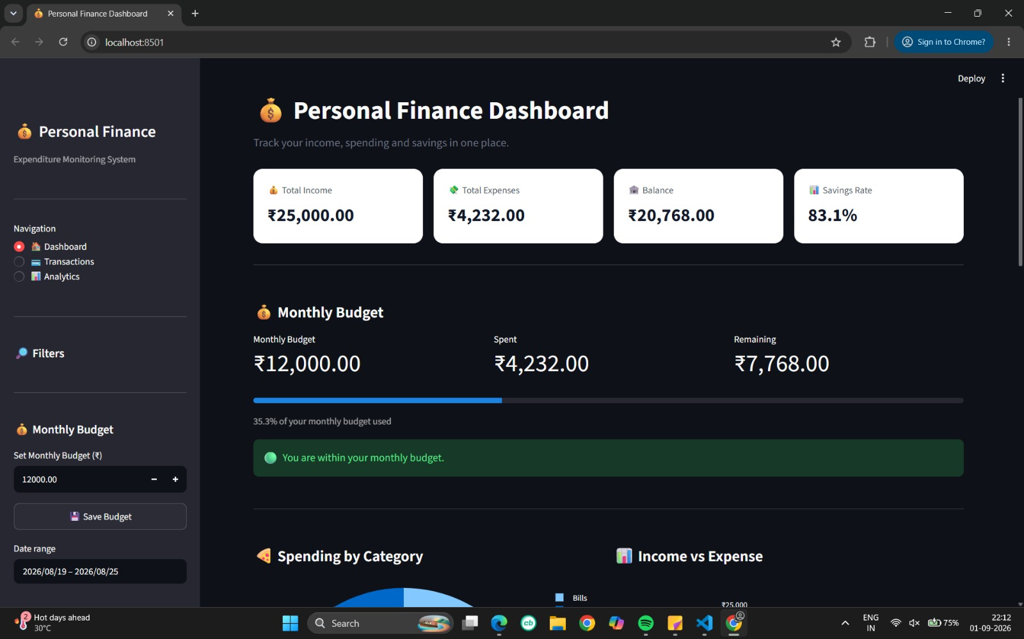
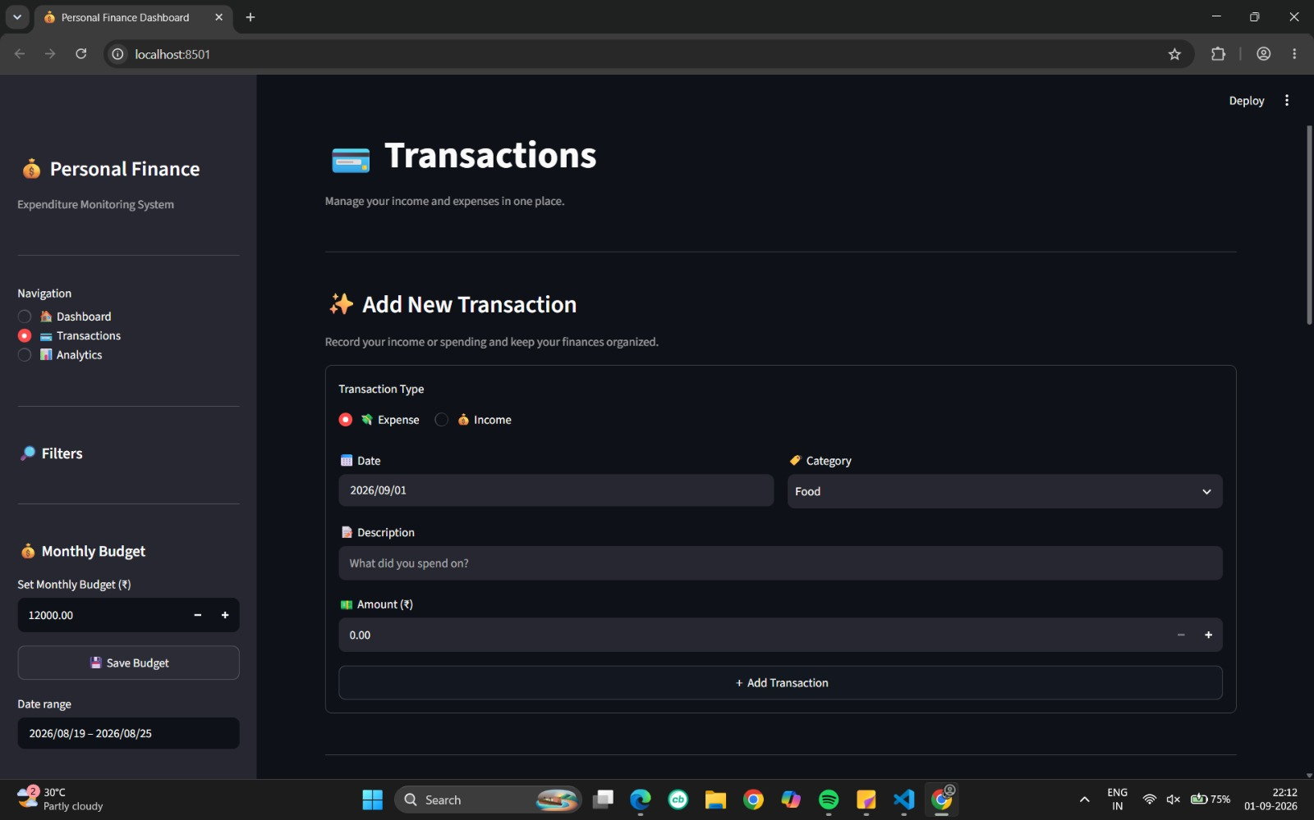
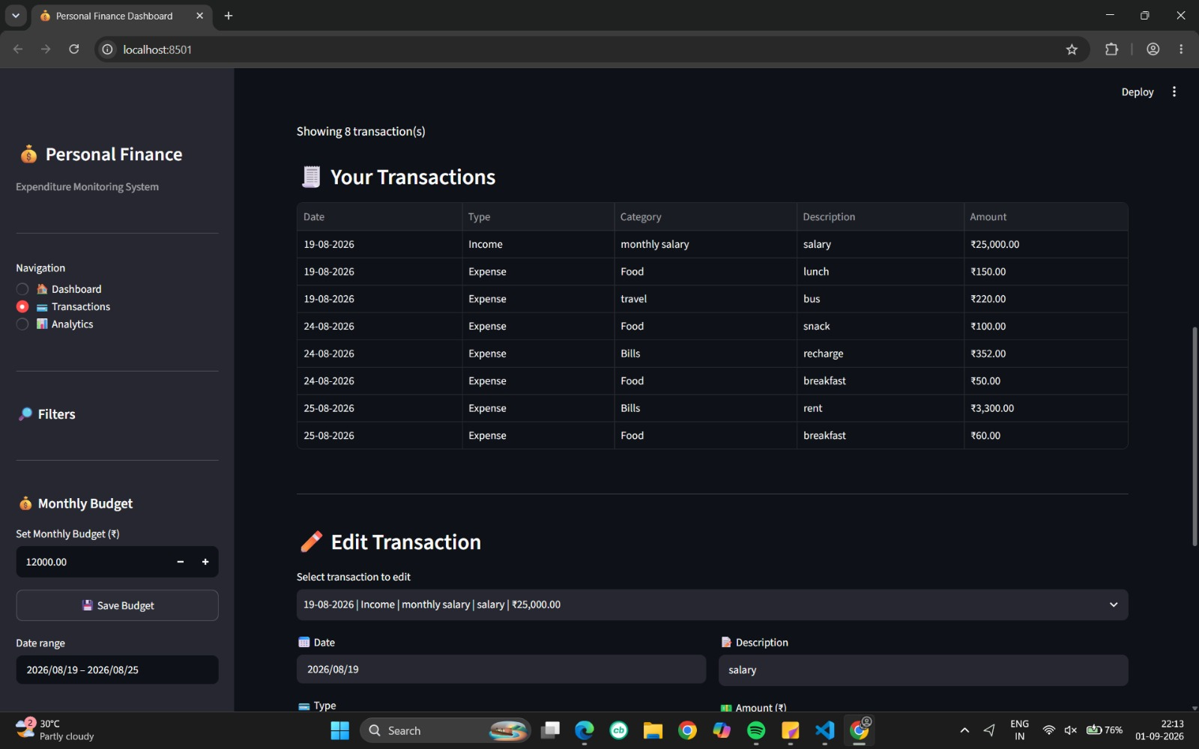
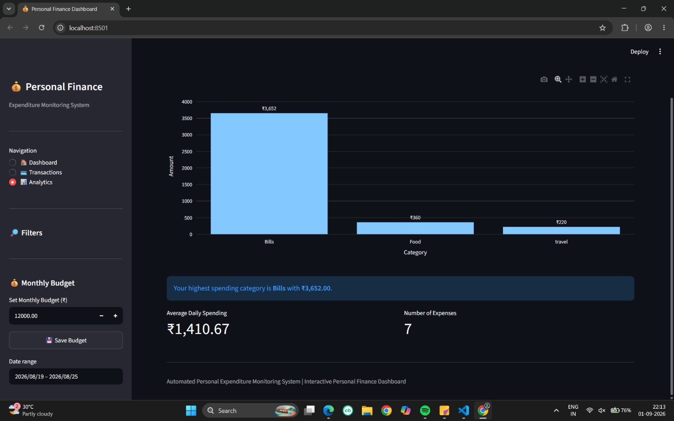
IMPLEMENTATION OUTPUT

Slide 12
SYSTEM ADVANTAGES
Automation - Reduces repetitive manual calculations.
Centralized Records - Maintains income and expenditure information in one system.
Data Organization - Categorization makes expenditure easier to understand.
Budget Awareness - Provides immediate visibility into budget consumption.
Analytical Decision Support - Charts and financial indicators help identify spending patterns.
User-Friendly Interface - The dashboard provides a structured interface for managing and analysing transactions.

Slide 13
LIMITATIONS
Current limitations
CSV-based storage is suitable for small-scale usage but not ideal for large datasets.
No user authentication or multi-user account management.
Financial reports are primarily dashboard-based.
No automated bank-account integration.
Limited predictive financial analysis.
No dedicated mobile application.
Advanced financial forecasting is not currently implemented.

Slide 14
FUTURE ENHANCEMENTS
The system can be extended into a more comprehensive personal-finance platform.
1. Database Integration - Replace CSV storage with MySQL, PostgreSQL or SQLite for scalable data management.
2. User Authentication - Introduce secure login and individual financial profiles.
3. Automated Report Export - Generate downloadable PDF/Excel financial reports.
4. Advanced Budgeting - Support category-specific budgets and recurring expenses.
5. Predictive Analytics - Estimate future expenditure using historical spending patterns.

Slide 15
CONCLUSION
The Automated Personal Expenditure Monitoring System provides a structured approach to managing personal financial information
The project successfully demonstrates:
Systematic income and expense recording
Persistent transaction management
Automated financial calculations
Monthly budget monitoring
Category-wise expenditure analysis
Graphical financial visualization

Slide 16
THANK YOU

